Slide 1


Using FPGAs for Systems Research Successes, Failures, and Lessons
Jared Casper, Michael Dalton, Sungpack Hong, Hari Kannan, Nju Njoroge, Tayo Oguntebi, Sewook Wee, Kunle Olukotun,
Christos Kozyrakis
Stanford University
Talk at RAMP Wrap Event – August 2010

Slide 2
Use of FPGAs at Stanford
A mean to continue Stanford’s systems tradition
MIPS, MIPS-X, DASH, FLASH, …
Four main efforts from 2004 till today
ATLAS: a CMP with hardware for transactional memory
FARM: a flexible platform for prototyping accelerators
Raksha: architectural support for software security
Smart Memories: verification of a configurable CMP
See talk by M. Horowitz tomorrow

Slide 3
Common Goals
Provide fast platforms for software development
What can apps/OS do with new hardware features?
Have the HW platform early in the project
Fast iterations between HW and SW
Capture primary performance issues
E.g., scaling trends, bandwidth limitations,…
Expose HW implementation challenges
Not a goal: accurate simulation of a target uarch

Slide 4
ATLAS (aka RAMP-Red)
CPU0
CPU1
CPU2
CPU7
…
Cache +TM
Cache +TM
Cache +TM
Cache +TM
Coherent Bus with TM Support
Main Memory & I/O
Goal: a fast emulator of the TCC architecture
TCC: hardware support for transactional memory
Caches track read/write sets; bus enforces atomicity
What does this mean for system and for software?

Slide 5
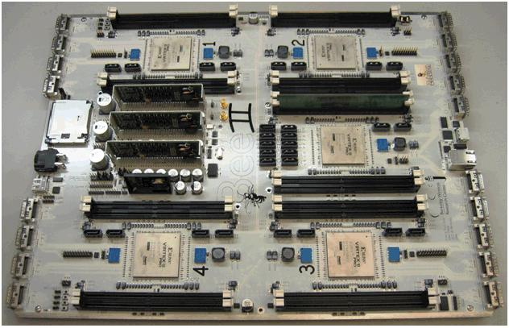
ATLAS on the BEE2 Board
PPC 0
+ TM
PPC 1
+ TM
Linux PPC
PPC 4
+ TM
PPC 5
+ TM
User Switch
Control Switch
User Switch
User Switch
User Switch
PPC 2
+ TM
PPC 3
+ TM
I/O
DRAM
PPC 7
+ TM
PPC 8
+ TM
9-way CMP system at 100MHz
Use hardwired PPC cores but synthesized caches
Uniform memory architecture
Full Linux 2.6 environment

Slide 6
ATLAS Successes
1st hardware TM system
100x faster than our simulator
Close match in scaling trend & TM bottleneck analysis
Ran high-level application code
Targeted by our OpenTM framework (OpenMP+TM)
Research using ATLAS
A partitioned OS from CMPs with TM support
A practical tool for TM performance debugging
Deterministic replay using TM
Automatic detection for atomicity violations

Slide 7
ATLAS Successes (cont)
Hands-on tutorials at ISCA’06 & ASPLOS’08
>60 participants from industry & academic
Wrote, debugged, and tuned parallel apps on ATLAS
From sequential to ideal speedup in minutes

Slide 8
ATLAS Failures
Limited interest by software researchers
Still too slow compared to commercial systems (latency)
9 PPC cores at 100MHz slower than a single Xeon core
We are competing with Xeons & Opterons, not just simulators!!
Large-scale will be the key answer here
Small number of boards available (bandwidth)
The need for cheap platforms
Software availability for (embedded) PowerPC cores
Java, databases, etc

Slide 9
Lessons from ATLAS
Software researchers need fast base CPU & rich SW environment
Pick FPGA board with large user community
Tools/IP compatibility and maturity are crucial
IP modules should have good debugging interfaces
Designs that cross board boundaries are difficult
FPGAs as a research tool
Adding debugging/profiling/etc features is straightforward
Changing the underlying architecture can be very difficult

Slide 10
FARM: Flexible Architecture Research Machine
Goal: fix the primary issue with ATLAS
Fast base CPU & rich software environment
FARM features
Use systems with FPGAs on coherence fabric
Commodity full-speed CPUs, memory, I/O
Rich SW support (OS, compilers, debugger … )
Real applications and real input data
Tradeoff: cannot change the CPU chip or bus protocol
But can work on closely coupled accelerators for compute (e.g., new cores), memory, and I/O
Can put a new computer in the FPGA as well

Slide 11
FARM Hardware Vision
CPU + GPU for base computing
FPGAs add the flexibility
Extensible to multiboard
Through high-speed network
Many emerging boards that match the description
DRC, XtremeData, Xilinx/Intel, ACP, A&D Procyon
Memory
Memory
Core 0
Core 1
Core 0
Core 1
Core 2
Core 3
Core 2
Core 3
GPU / Stream
FPGA
IO
SRAM
Memory
Memory

Slide 12
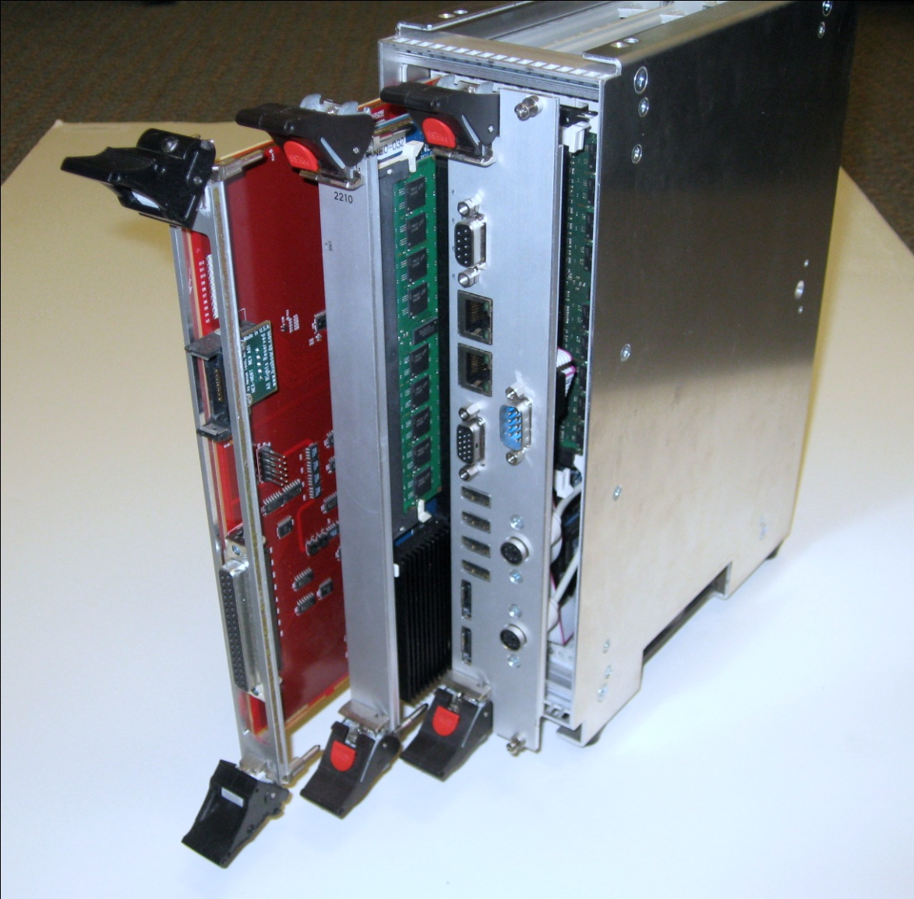
The Procyon Board by A&D Tech
Initial platform for single FARM node
CPU Unit (x2)
AMD Opteron Socket F (Barcelona)
DDR2 DIMMs x 2
FPGA Unit (x1)
Stratix II, SRAM, DDR, debug
Units are boards on cHT backplane
Coherent HyperTransport (version 2)
Implemented cHT compatibility for FPGA unit

Slide 13
Inside FARM
Altera Stratix II FPGA (132k Logic Gates)‏
1.8G
Core 0
64K L1
1.8G
Core 3
64K L1
1.8G
Core 0
64K L1
1.8G
Core 3
64K L1
…
…
MMR
IF
User Application
512KB
L2 Cache
512KB
L2 Cache
512KB
L2 Cache
512KB
L2 Cache
Cache IF
Configurable
Coherent Cache
Data Stream IF
2MB
L3 Shared Cache
2MB
L3 Shared Cache
Data
Transfer Engine
Hyper
Transport
32 Gbps
Hyper
Transport
6.4 Gbps
cHTCore™
Hyper Transport (PHY, LINK)‏
32 Gbps
~60ns
6.4 Gbps
~380ns
AMD Barcelona
*cHTCore by the University of Manhiem
Interfaces to user application
Coherent caches, streaming, memory-mapped registers
Write buffers, prefetching, epochs for ordering, …
Verification environment

Slide 14
FARM Successes (so far)
Up and running
Coherent interface, OS modules, user libs, verification, …
TMACC: an off-core TM accelerator
Hardware TM support without changing cores/caches
Large performance gains for coarse-grain transactions
The important case for TM research
Over STM or threaded core running on Opterons
Showcases simpler deployment approaches for TM
Ongoing work on heterogeneous accelerators
For compute, memory, I/O, programmability, security, …

Slide 15
FARM Failures
Too early to say…

Slide 16
Lessons from FARM (so far)
CPU+FPGA boards are promising but not mature yet
Availability, stability, docs, integration, features, …
We had several false starts: DRC, XtremeData
Forward compatibility of infrastructure is still an unknown
Vendor support and openness is crucial
Faced long delays and roadblocks in many cases
This is what made the difference with A&D Tech
Cores & systems not yet optimized for coherent accelerators
Most work goes into CPU/FPGA interaction (HW and SW)
Will likely change thanks to CPU/GPU fusion and I/O virtualization

Slide 17
Raksha: Architectural Support for Software Security
Goal: develop & realistically evaluate HW security features
Avoid pitfalls of separate methodologies for functionality and performance
Primarily focused on dynamic information flow tracking (DIFT)
Primary prototyping requirements
A baseline core we could easily change
Simple core, mature design, reasonable support
Rich software base (Linux, libraries, software)
SW modules and security policies a critical part of our work
Also needed for credible evaluation
Low cost FPGA system

Slide 18
Raksha: 1st Generation
I-Cache
Decode
RegFile
D-Cache
Traps
WB
PC
ALU
Policy Decode
Tag ALU
Tag Check
Base: Leon Sparc V8 core + Xilinx XUP board
Met all our critical requirements
Changes to the Leon design
New op mode, multi-bit tags on state, check & propagate logic, …
Security checks on user code and unmodified Linux
No false positives
Notes:
1 slide on pipeline
- state extended by tags
- tag ops in parallel with data ops (same forwarding etc)
1 slide on multigranularity tags through software
- machine supports world-level tags
- coarse-grain to lower the overhead (see Suh’s paper)
- byte or bit level using software handler to maintain metadata on the side (say about ok if uncommon)

Slide 19
Raksha: 2nd Generation
Security exception
Processor
Core
Tag ALU
PC, Inst, Address
Policy Decode
Tag RF
Tag Check
W B
Tag Cache
ROB
DIFT Coprocessor
I Cache
D Cache
L2 Cache
Repositioned hardware support to a small coprocessor
Motivated by industry feedback after using prototype
Complex pipelines are difficult to change/verify
No changes to the main core; reusable coprocessor; minor performance overhead
Notes:
1 slide on pipeline
- state extended by tags
- tag ops in parallel with data ops (same forwarding etc)
1 slide on multigranularity tags through software
- machine supports world-level tags
- coarse-grain to lower the overhead (see Suh’s paper)
- byte or bit level using software handler to maintain metadata on the side (say about ok if uncommon)

Slide 20
Raksha: 3rd Generation (Loki)
I-Cache
Decode
RegFile
D-Cache
Traps
WB
ALU
Read/Write
P-Cache
Permission
Checks
Execute
P-Cache
Collaboration with David Mazieres’ security group
Loki: HW support for information flow control
Tags encode SW labels for access rights; enforced by HW
Loki + HiStar OS: enforce app security policies with 5KLOC of trusted OS code
HW can enforce policies even if rest of OS is compromised
Notes:
1 slide on pipeline
- state extended by tags
- tag ops in parallel with data ops (same forwarding etc)
1 slide on multigranularity tags through software
- machine supports world-level tags
- coarse-grain to lower the overhead (see Suh’s paper)
- byte or bit level using software handler to maintain metadata on the side (say about ok if uncommon)

Slide 21
Raksha Successes
Provided a solid platform for systems research
All but 2 Raksha papers used FPGA boards
Including papers focusing on security policies
Showcased the need for HW/SW co-design
Showed that security policies developed with simulation are flawed!!
Convincing results with lots of software
Two Oses, LAMP stack, 14k software packages
Fast HW/SW iterations with a small team
3+ designs by 2 students in 3.5 years
Shared it with 4 other institutes
Academia and industry

Slide 22
Raksha Failures
?

Slide 23
Lessons from Raksha
The importance of a robust base
Base core(s), FPGA board, debug, CAD tools, …
Keep it simple, stupid
Just like other tools, a single FPGA-based tool cannot do it all
Build multiple tools, each with a narrow focus
Can share across tools under the hood though
Don’t over-optimize HW; work on SW and system as well
Killer app for RAMP may not be about performance
Difficult to compete with CPUs/GPUs on performance
But possible to have other features that attract external users

Slide 24
Conclusions
FPGA frameworks are playing a role in systems research
We delivered on a significant % of the RAMP vision
Demonstrated feasibility and advantages
Research results using FPGA environments
Understand better the constraints and potential solutions
The road ahead
Scalability (1,000s of cores), ease-of-use, cost, …
Focus on frameworks with a narrower focus?
E.g., accelerators, security, …
Sharing between frameworks under the hood

Slide 25
Questions?
More info and papers from there projects at http://csl.stanford.edu/~christos

